Slide 1
Steiner Triple Systems
Presenter: Joshua Ganschow
Project Collaboration with Dr. Justin Schroeder

Slide 2
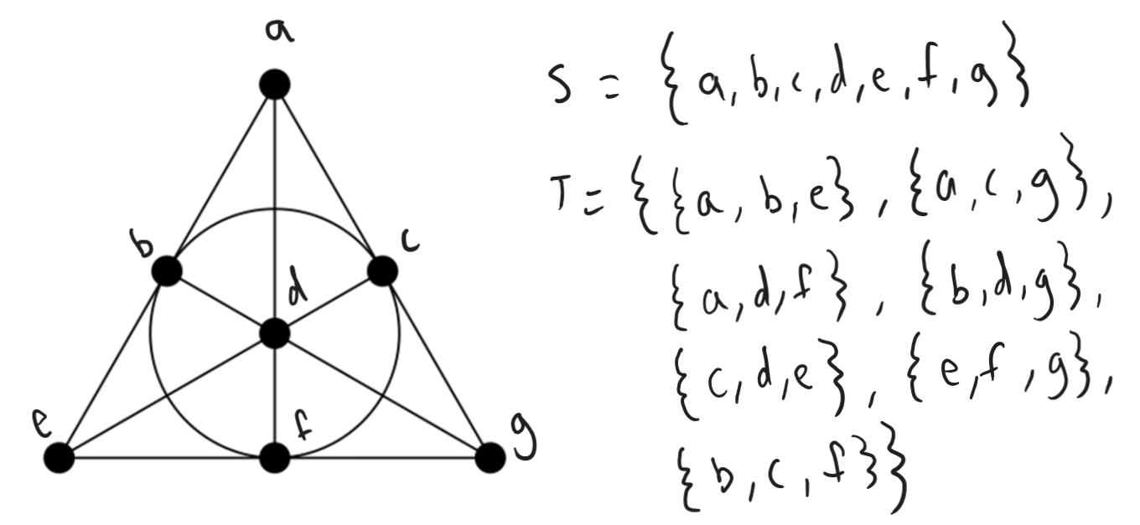
Overview
A Steiner Triple System (aka STS) is an ordered pair (S, T) where S is a finite set of points and T is a set of 3-element subsets of S called triples, such that each pair of distinct elements of S occurs together in exactly one triple of S.

Slide 3
Overview
The order of an STS, (S, T), is the size of the set S (denoted |S|).
A Steiner System can be more generally thought of as S(t, k, n) an n-element set S together with a set of k-element subsets of S (called blocks) with the property that each t-element subset of S is contained in exactly one block.
So, the version of a Steiner System we examine is a S(2, 3, n) for order n, shortened to STS(n).
More specifically, we focused on the STS(25).

Slide 4

Properties
The total number of pairs is $n(n−1)/2$, so the total number of triples is $n(n−1)/6$.
n must be of the form $6k+1$ or $6k+3$ for some integer k
Graphs have a property known as a circumference, which is the length of the longest cycle in the graph.
Thus, the graph of an STS has a computable circumference (visualizations included later in presentation).
Notes:
25(25-1)/6 = 100

Slide 5
Properties
There is 1 (non-isomorphic) version of each STS(7) and STS(9)
There are 2 STS(13)s, 80 STS(15)s, and 11,084,874,829 STS(19)s.
Recently published: there are 14,796,207,517,873,771 (14.7 quadrillion) STS(21)
There are an unknown amount of STS(25)s
Notes:
A little extra background to get a sense of scale

Slide 6
Goals
The goal of the research project was as follows:
Reliable algorithm for quick generation of an STS(n) with a given n.
After that, algorithm for processing these generated systems to analyze their circumferences
Ideally looking for an STS(25) with a circumference of at most 12.

Slide 7
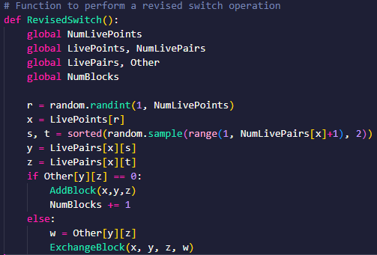
Method: Generation
Stinson’s Algorithm, as described in Combinatorial Algorithms: Generation, Enumeration, and Search.
A “hill-climbing” algorithm which continues adding triples into a group until that n(n-1)/6 number is reached.
Find a number that isn’t in enough groups yet
Pick two other numbers that haven’t been grouped with the first number
Try to form a group with these three numbers
If you can’t form a new group (i.e. invalid pairings), try swapping the offending element with another.
Repeat until all triples are created.
Randomness included to create a non-deterministic generation

Slide 8
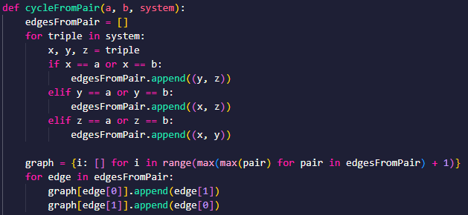
Method: Cycle (Path) Checking
Construct graph
Perform DFS
Analyze paths

Slide 9
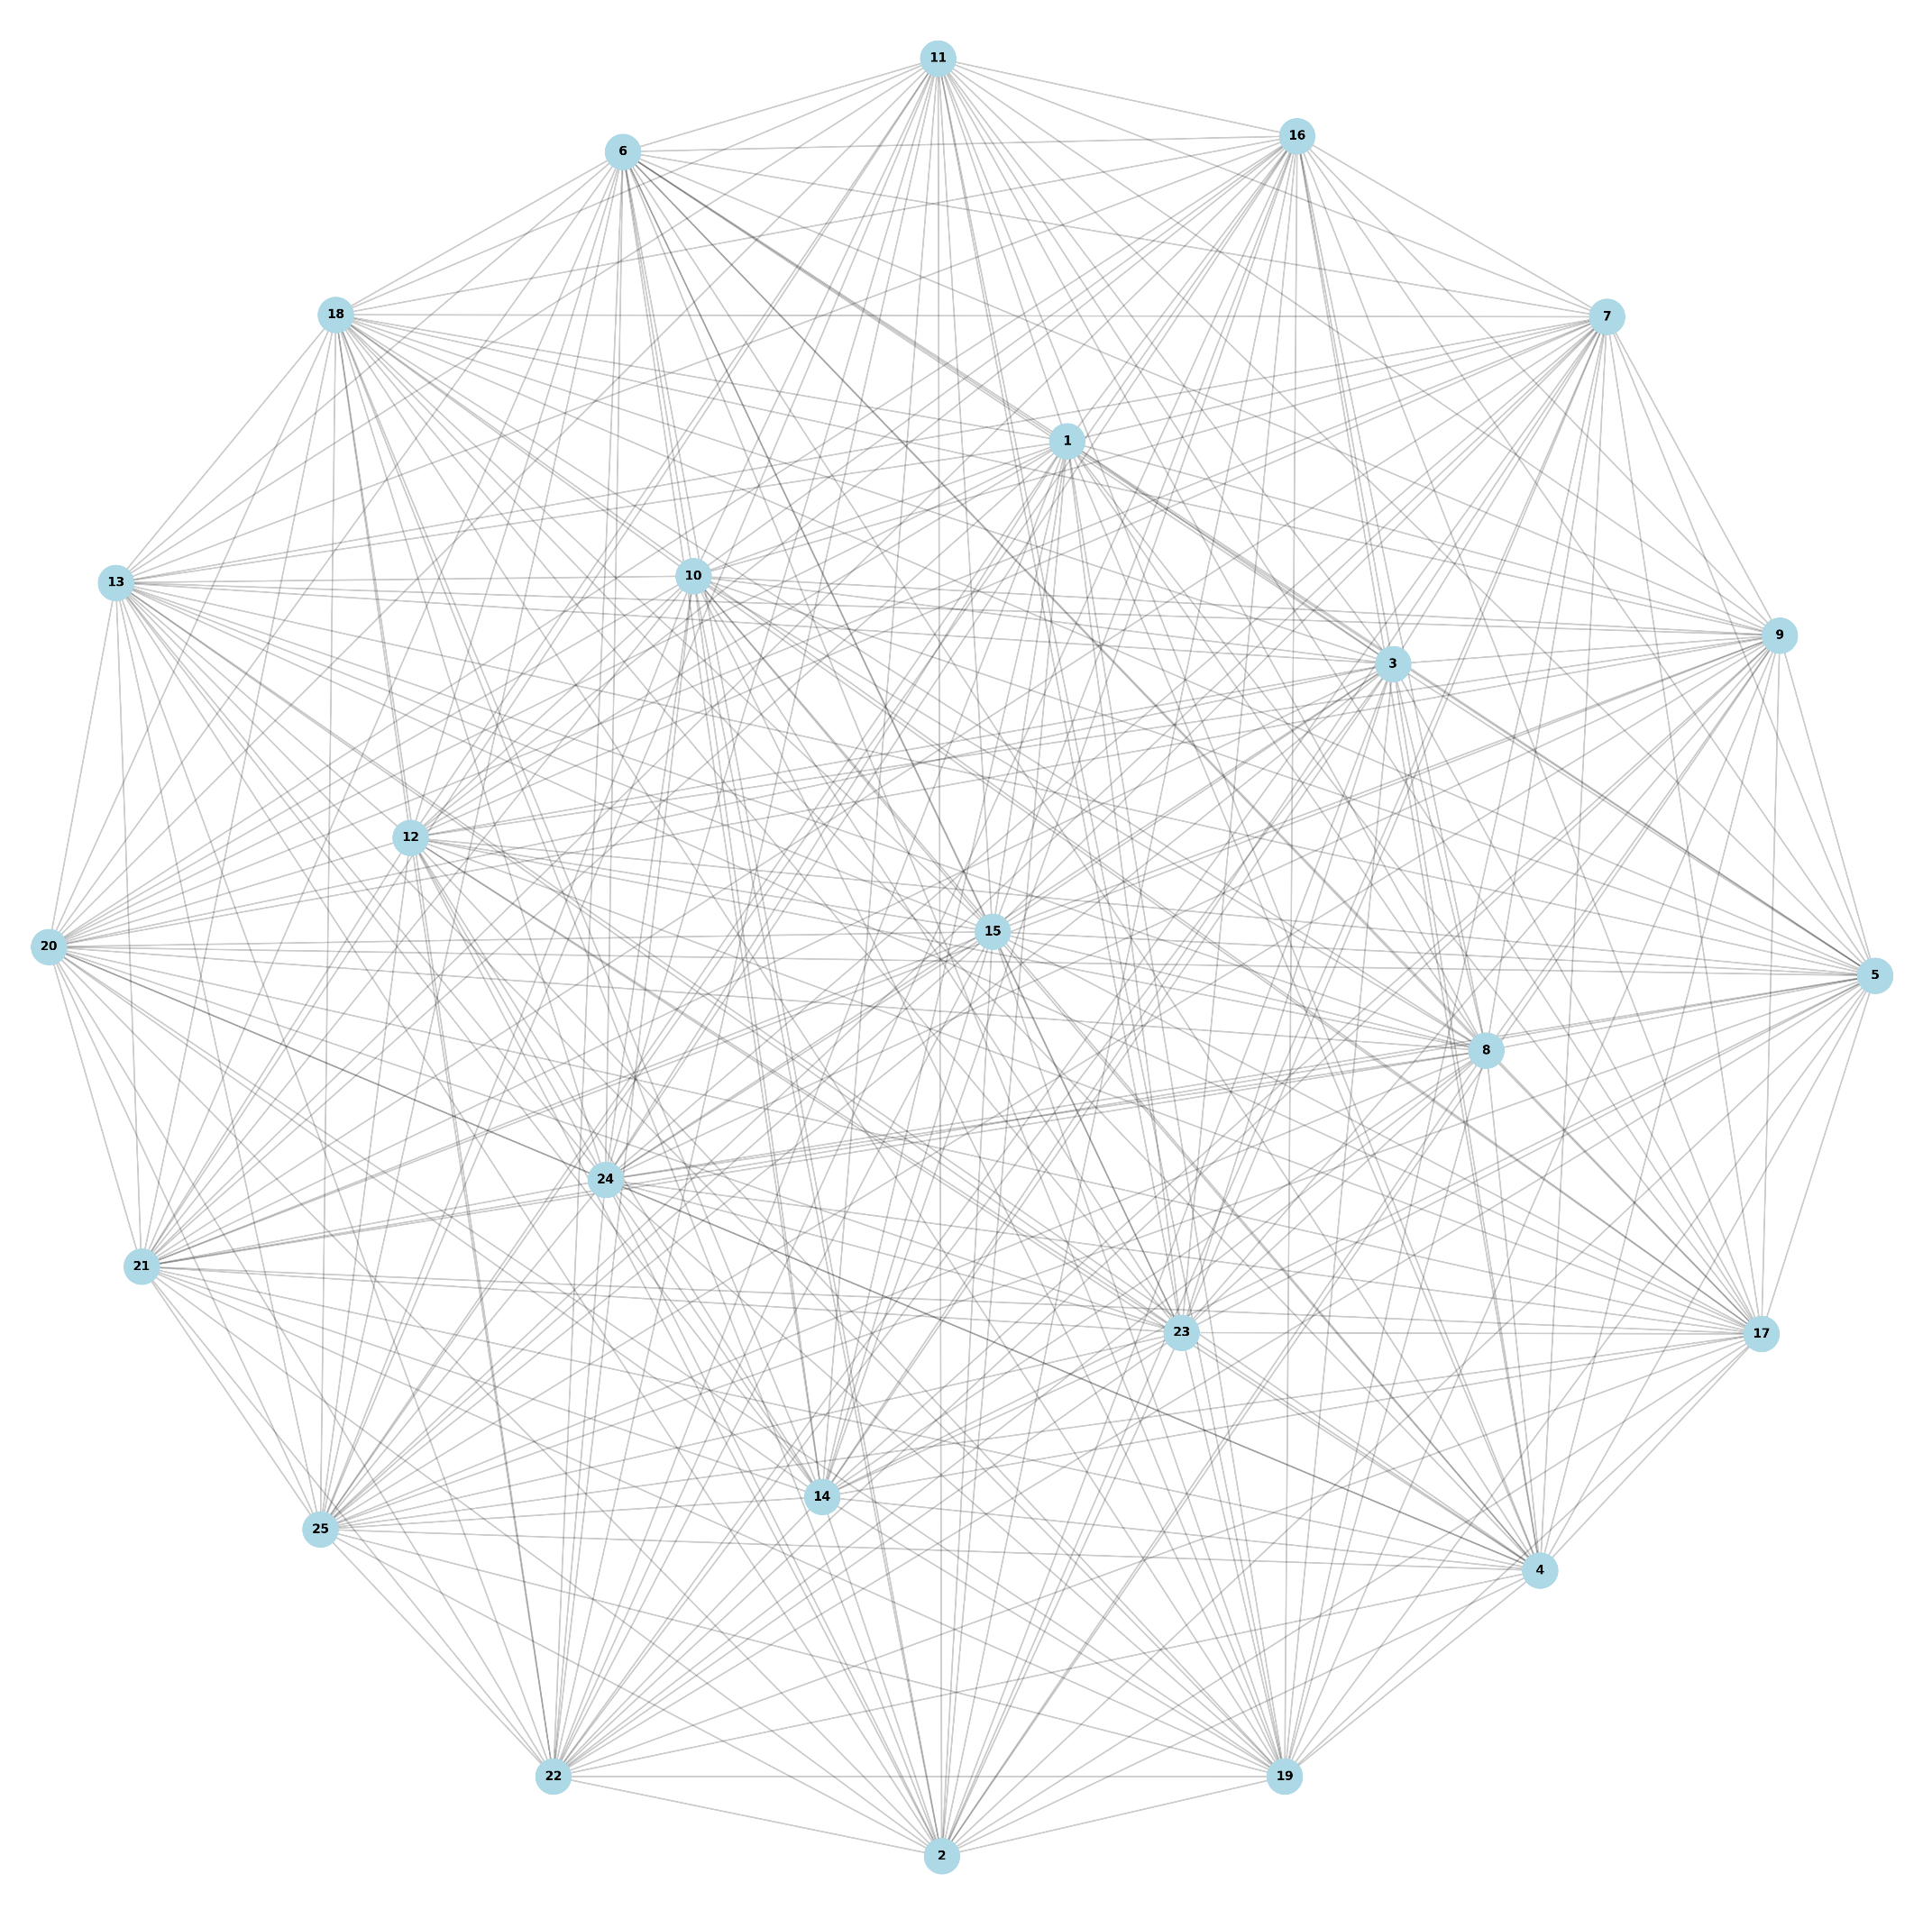
Circumference: Full Graph
Notes:
Circumference: 22

Slide 10
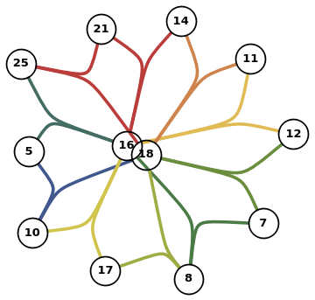
Cycle: (16, 18)
Notes:
18, 5, 10, 17, 8, 7, 12, 11, 14, 21, 25, 16
Length: 10

Slide 11
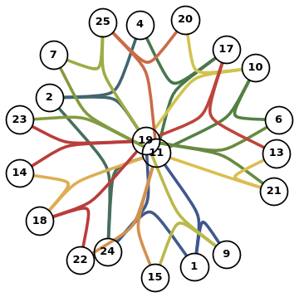
Cycle: (11, 19)
Notes:
19,9,15,22,18,14,23,7,25,20,10,6,21,13,17,4,2,24
Length: 18

Slide 12
Outcome
With these methods for generation and analysis, I generated ~1.2million systems and found exactly zero of them with the desired property.
Disappointing, but unsurprising, as a system with less complexity has 14.7 quadrillion different forms. 1.2 million barely scratches the surface.

Slide 13
Potential for Future Paths
The time complexity of the algorithms presented, despite attempting to tweak for efficiency, is still high (O(n^2) for generation and O(n^4) for circumference checking). This leaves a lot of potential improvement on the table.
Additionally, despite the team trying multiple different methods (each showed promise) for generation, none were able to generate systems with the desired small circumferences. A novel approach for generation of these systems (centered around purposeful generation of small cycles) could make a big difference.

Slide 14
Questions?

